Slide 1

BioPAX/Pathway Commons Software Ecosystem
MSKCC
Augustin Luna
lunaa@cbio.mskcc.org

Slide 2
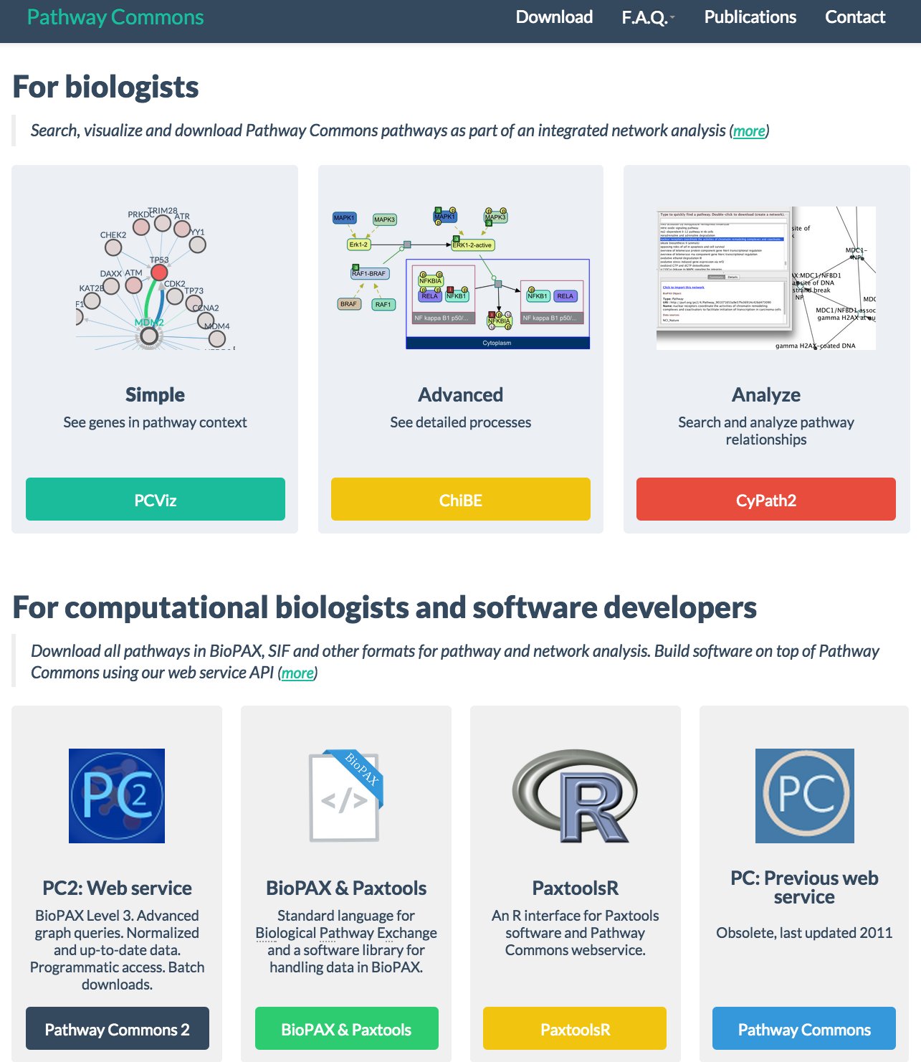
BioPAX/Pathway Commons Software Ecosystem
http://www.pathwaycommons.org/

Slide 3
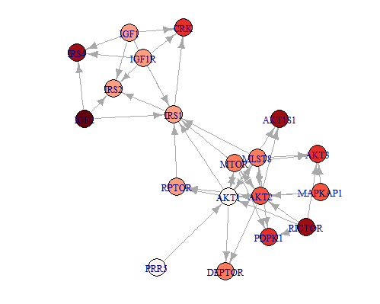
paxtoolsr
Features
Use Paxtools features on both local BioPAX files and Pathway Commons (PC) data
Extract subnetworks from aggregated PC data
Works primarily with expanded binary interactions; simplified from BioPAX representation
Provides R specific tutorials
Visualization; data overlay
Gene Set Enrichment Analysis
Image from paxtoolsR tutorial; a network queried from PC, converted to binary network using Paxtools, and overlayed with example data
Luna A, et al. in review

Slide 4
paxtoolsr: Development Version
Initial release focused on core Paxtools/Pathway Commons functionality
Development branch focuses on:
Speed improvements using R data.table
Caching mechanism for downloads
Better parsing of data into R objects
Better integration with existing R pathway analysis tools
igraph (general network analysis)
Analysis packages (e.g. SPIA for topological gene set enrichment)
NetboxR

Slide 5
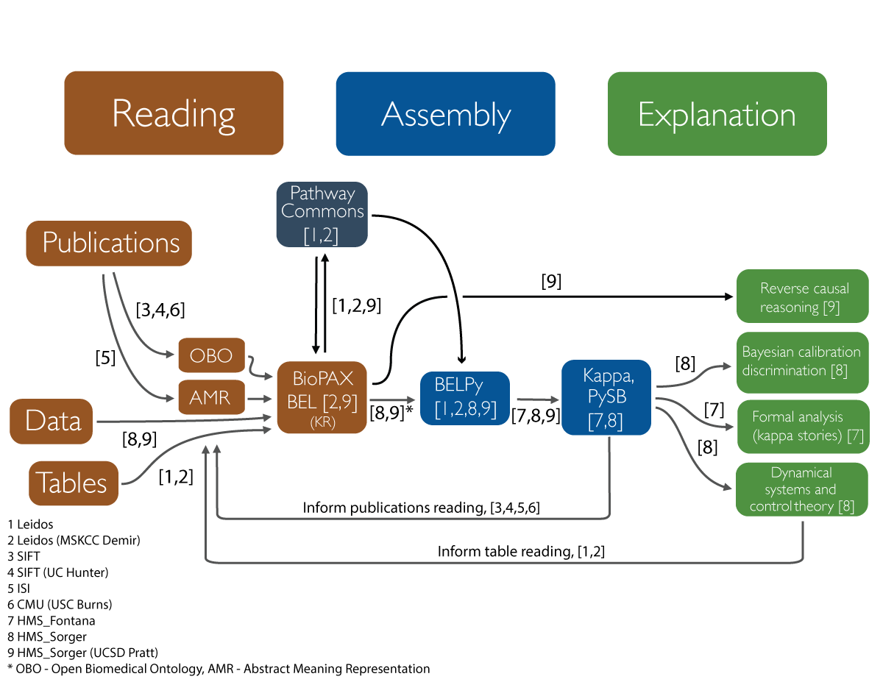
Novel Data Acquisition Through the DARPA Big Mechanism Project
http://www.darpa.mil/our-research

Slide 6
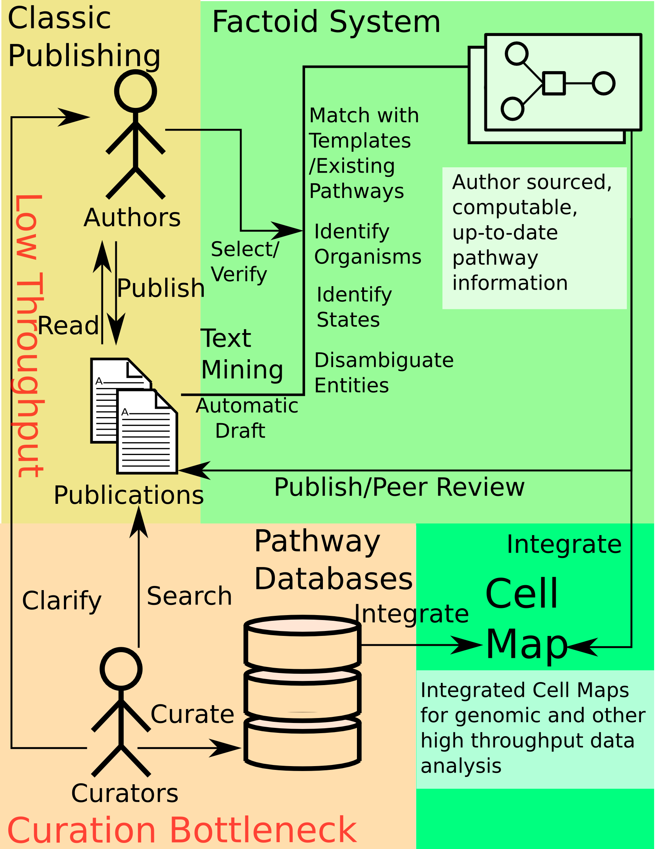
Factoid: Expanding Pathway Commons During Manuscript Submission Process

Slide 7
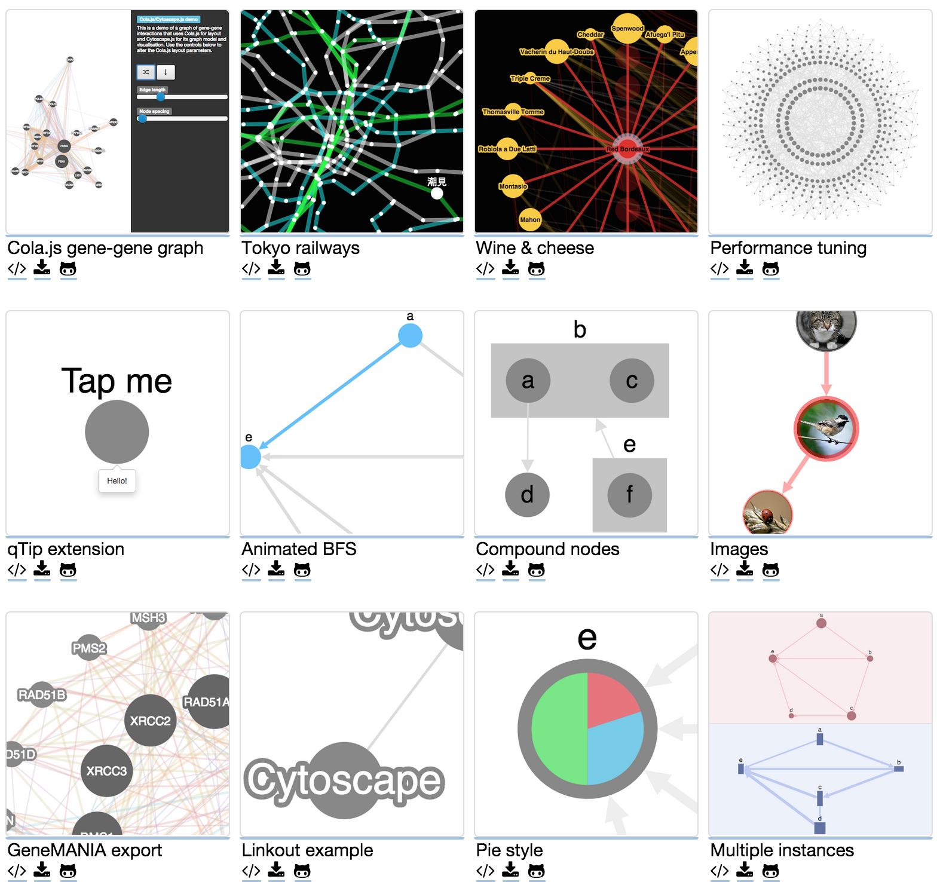
Cytoscape.js: A Javascript library for analysis and visualization of networks
Can handle large networks
Provides analysis algorithms
Provides various layouts
Customizable features
Colors
Tooltips
Linkouts
Node images
Compound nodes
…
Basis for other projects
PCViz
SBGNViz
Embed in R: https://github.com/cytoscape/r-cytoscape.js
http://js.cytoscape.org/

Slide 8
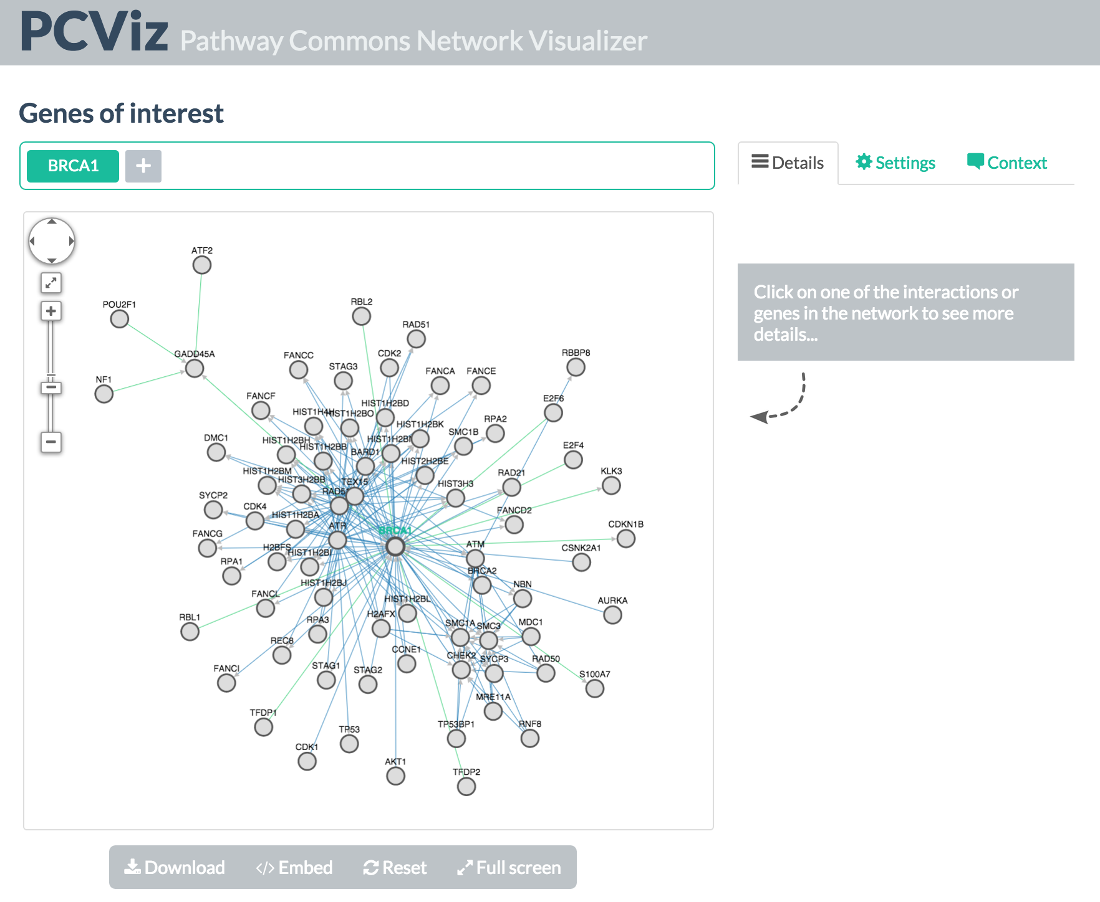
PCViz: Pathway Commons Network Visualizer
A SIF network visualizer
Will provide a detailed interaction view
Allows filtering interactions based on a gene co-citation filter
Allows cancer data overlay using cbioportal.org
Usable as an embeddable widget
http://www.pathwaycommons.org/pcviz/

Slide 9
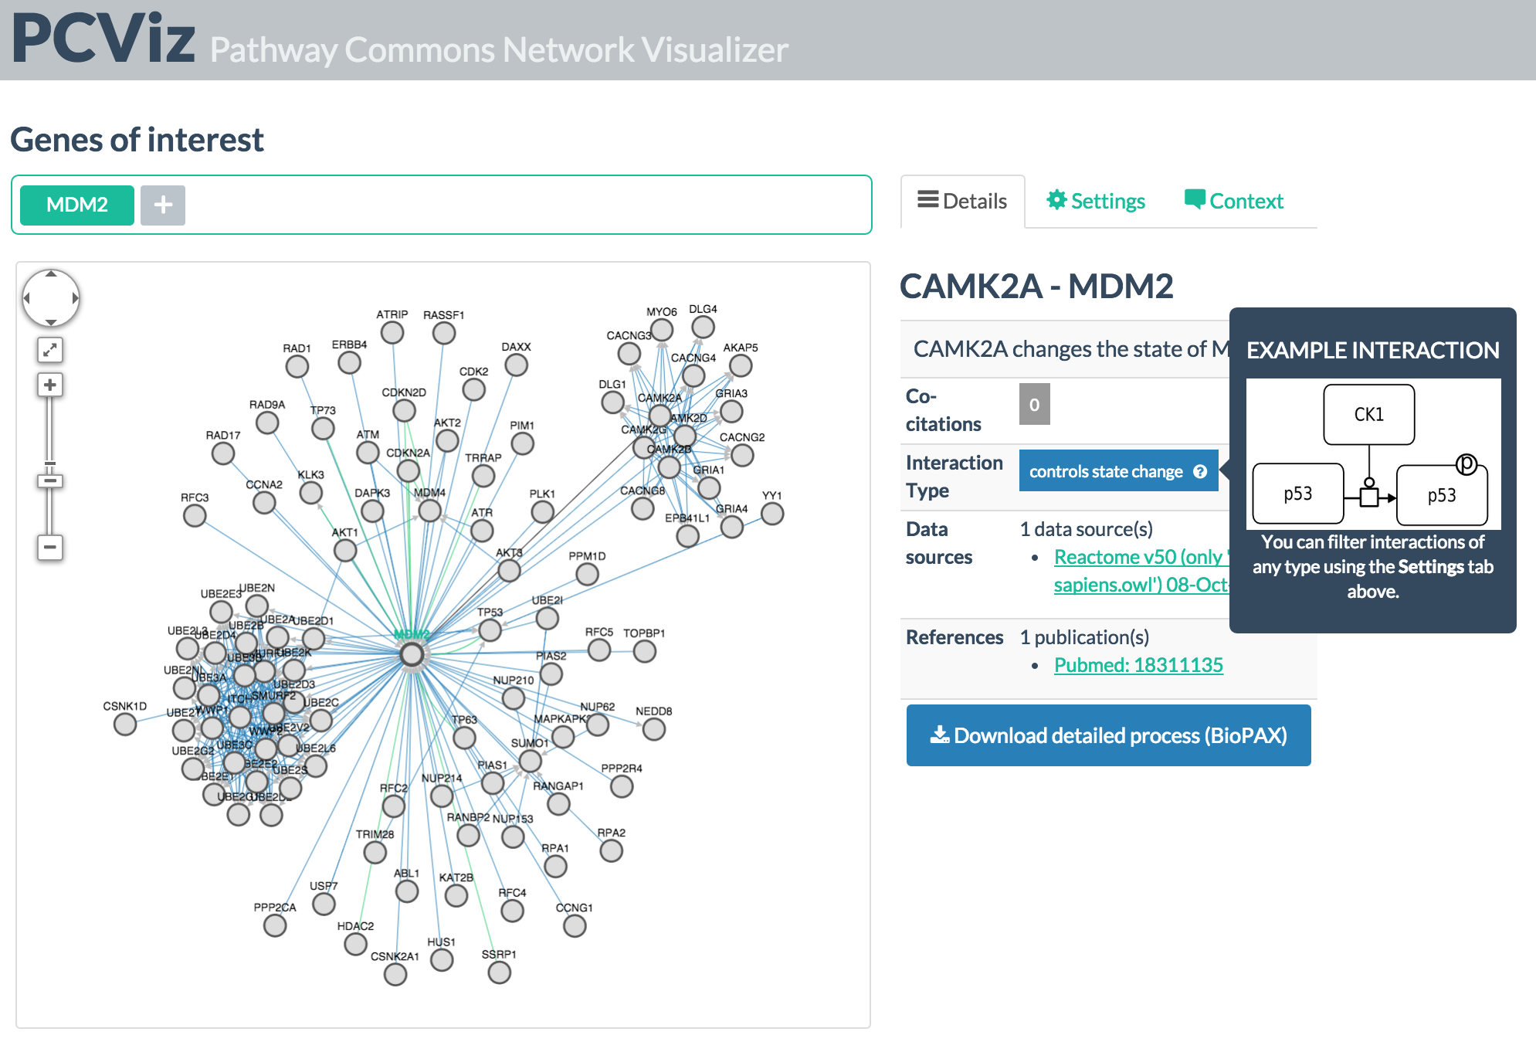
Detailed Views of Interactions

Slide 10
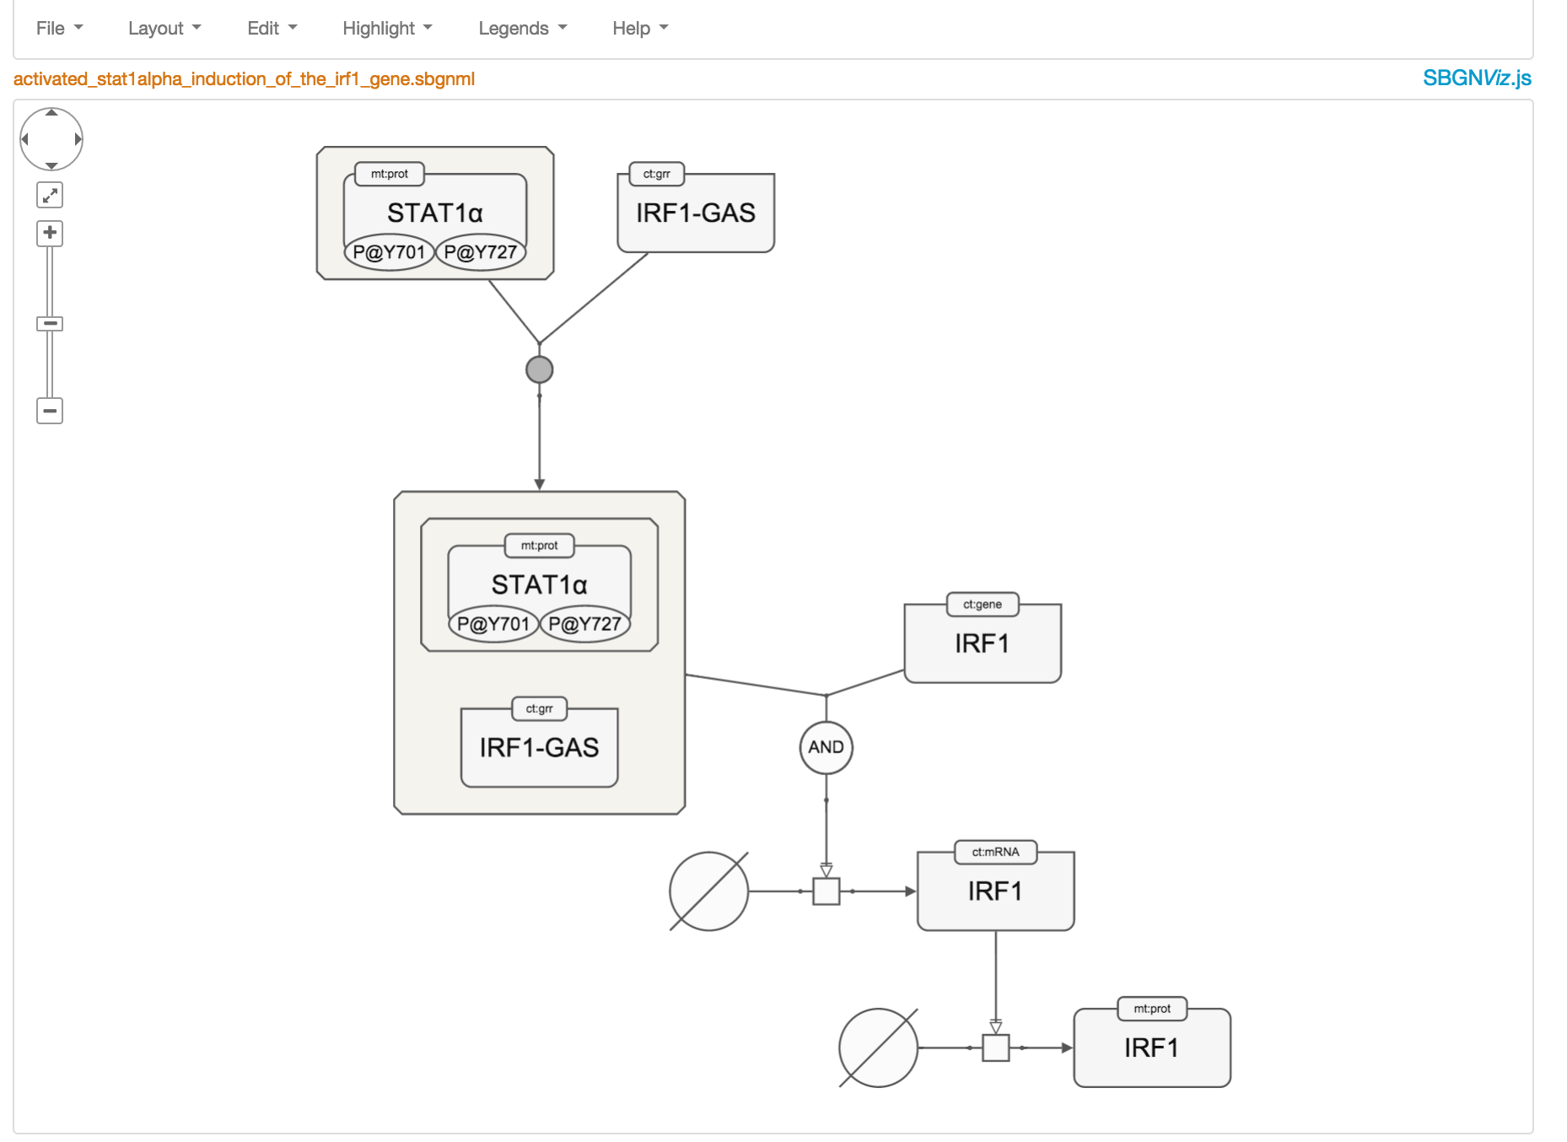
Systems Biology Graphical Notation (SBGN) and SBGNViz.js
Cytoscape.js lacks features for detailed network views
SBGNViz adds these features with SBGN support
SBGNViz (Ugur Dogrusoz and Onur Sumer)

Slide 11
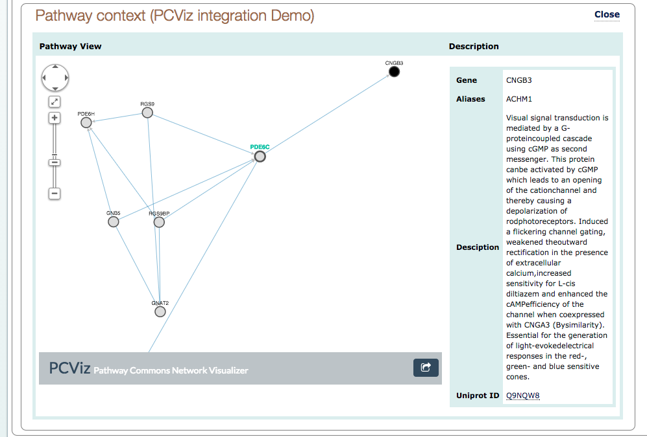
EnzymePortal Mockup
Mockup by Arman Aksoy

Slide 12
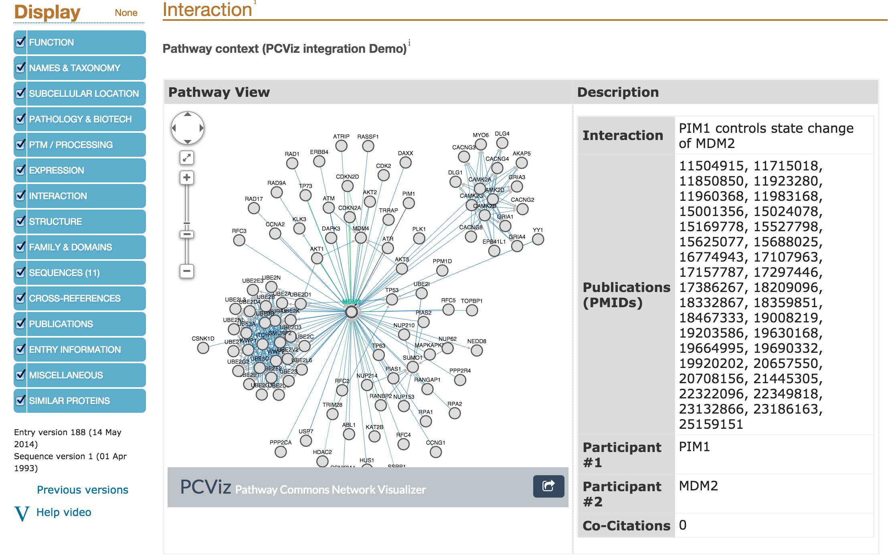
UniProt Mockup
Mockup by Arman Aksoy

Slide 13
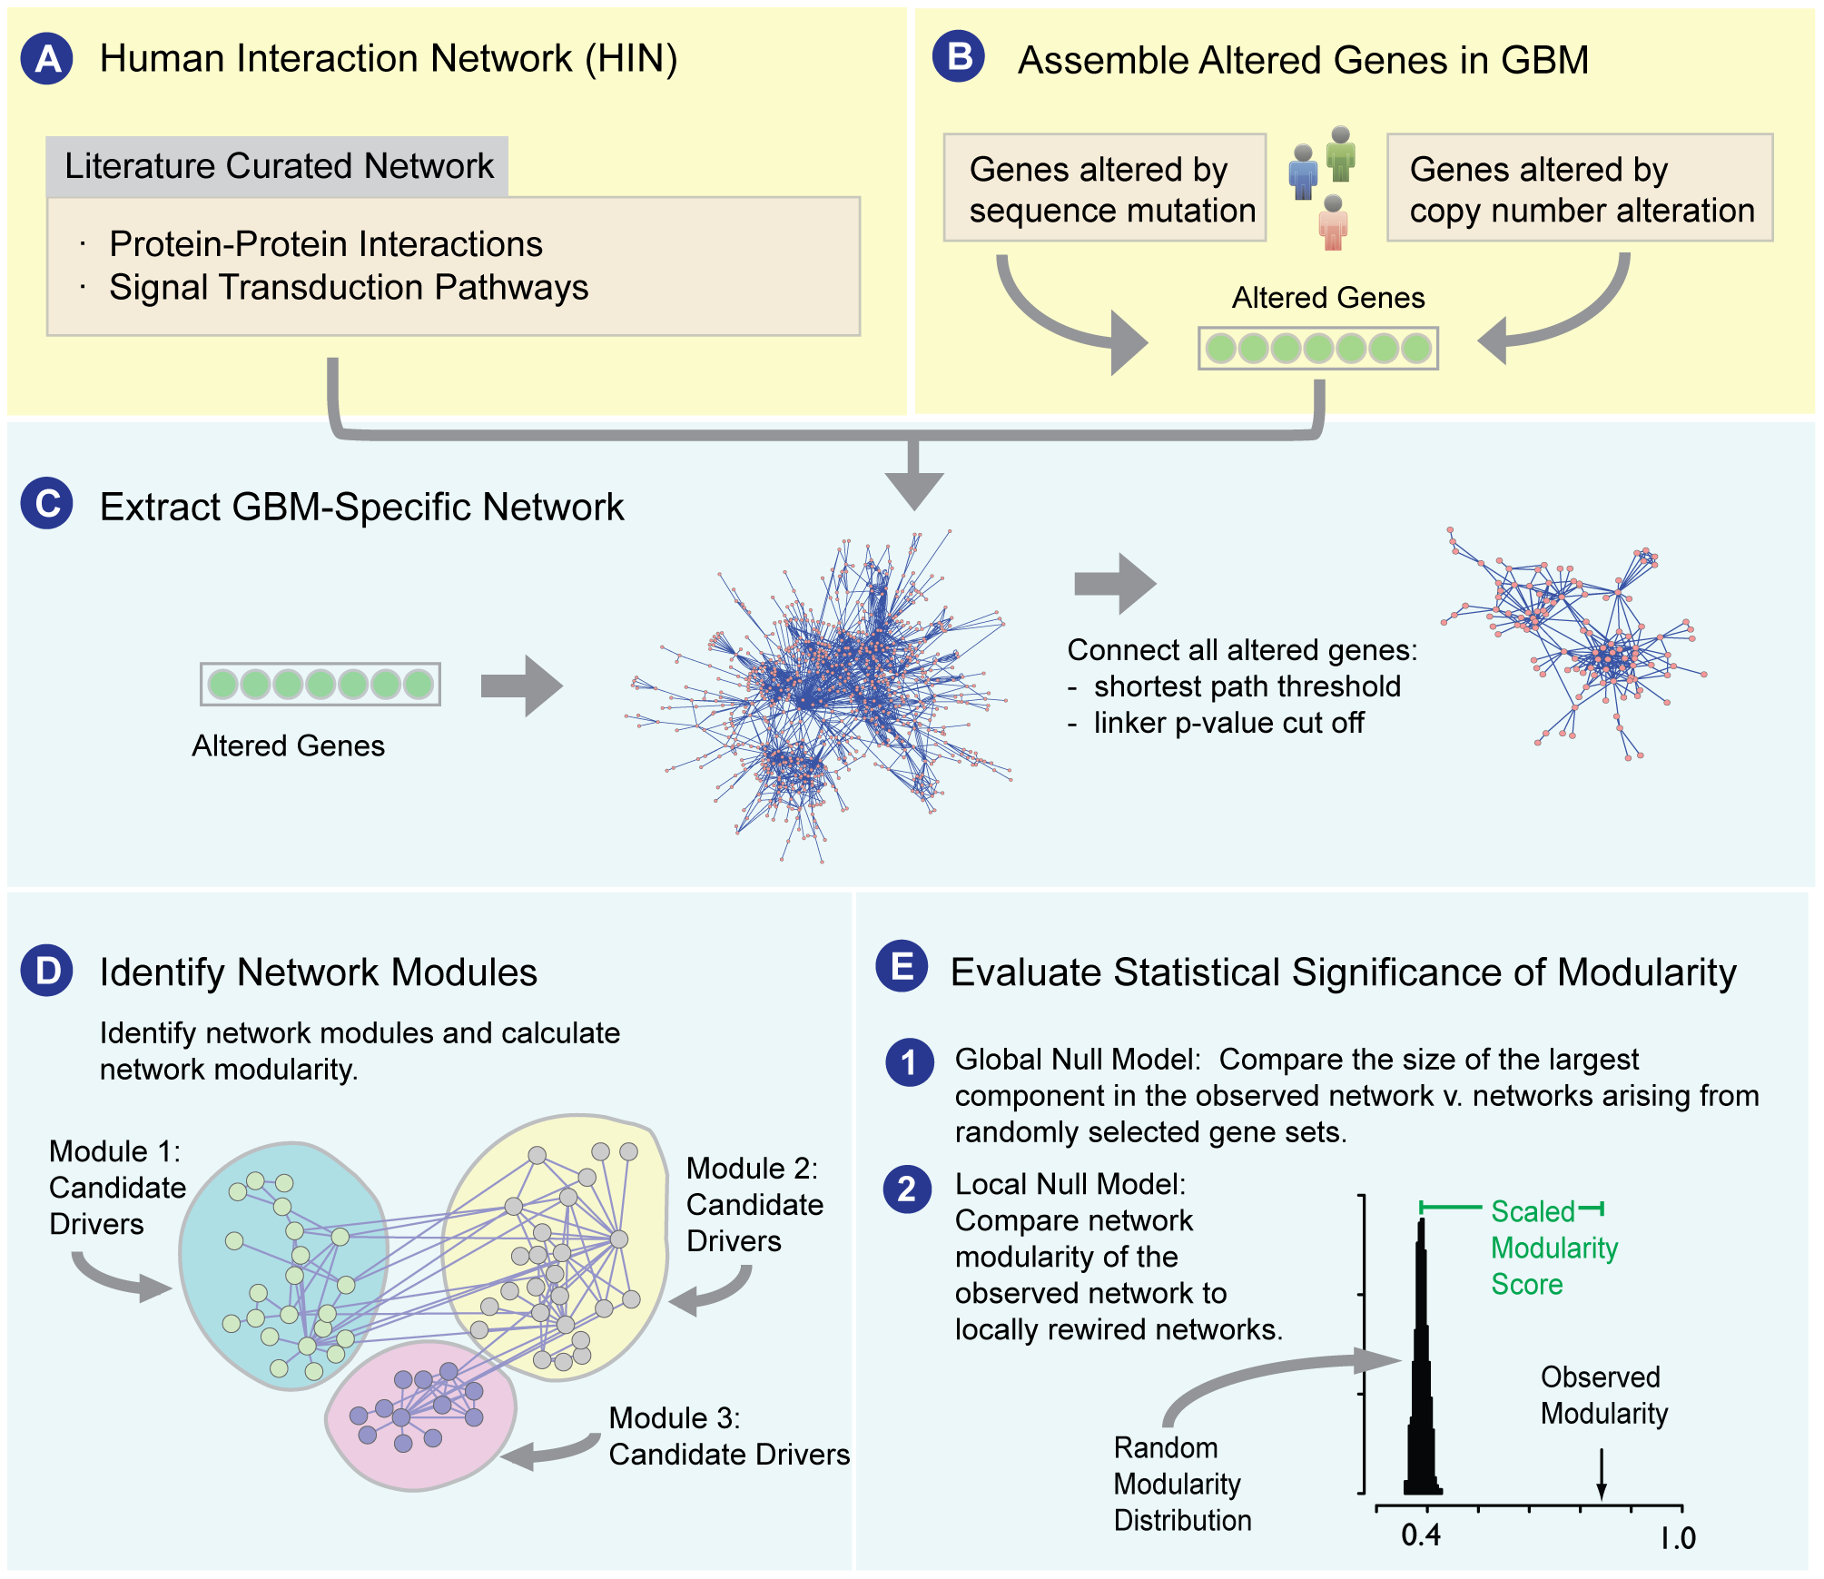
NetBox: Identification of Genes and Functional Modules Involved in Disease Processes and Progression
Cerami E, et al., (2010), PLoS ONE

Slide 14
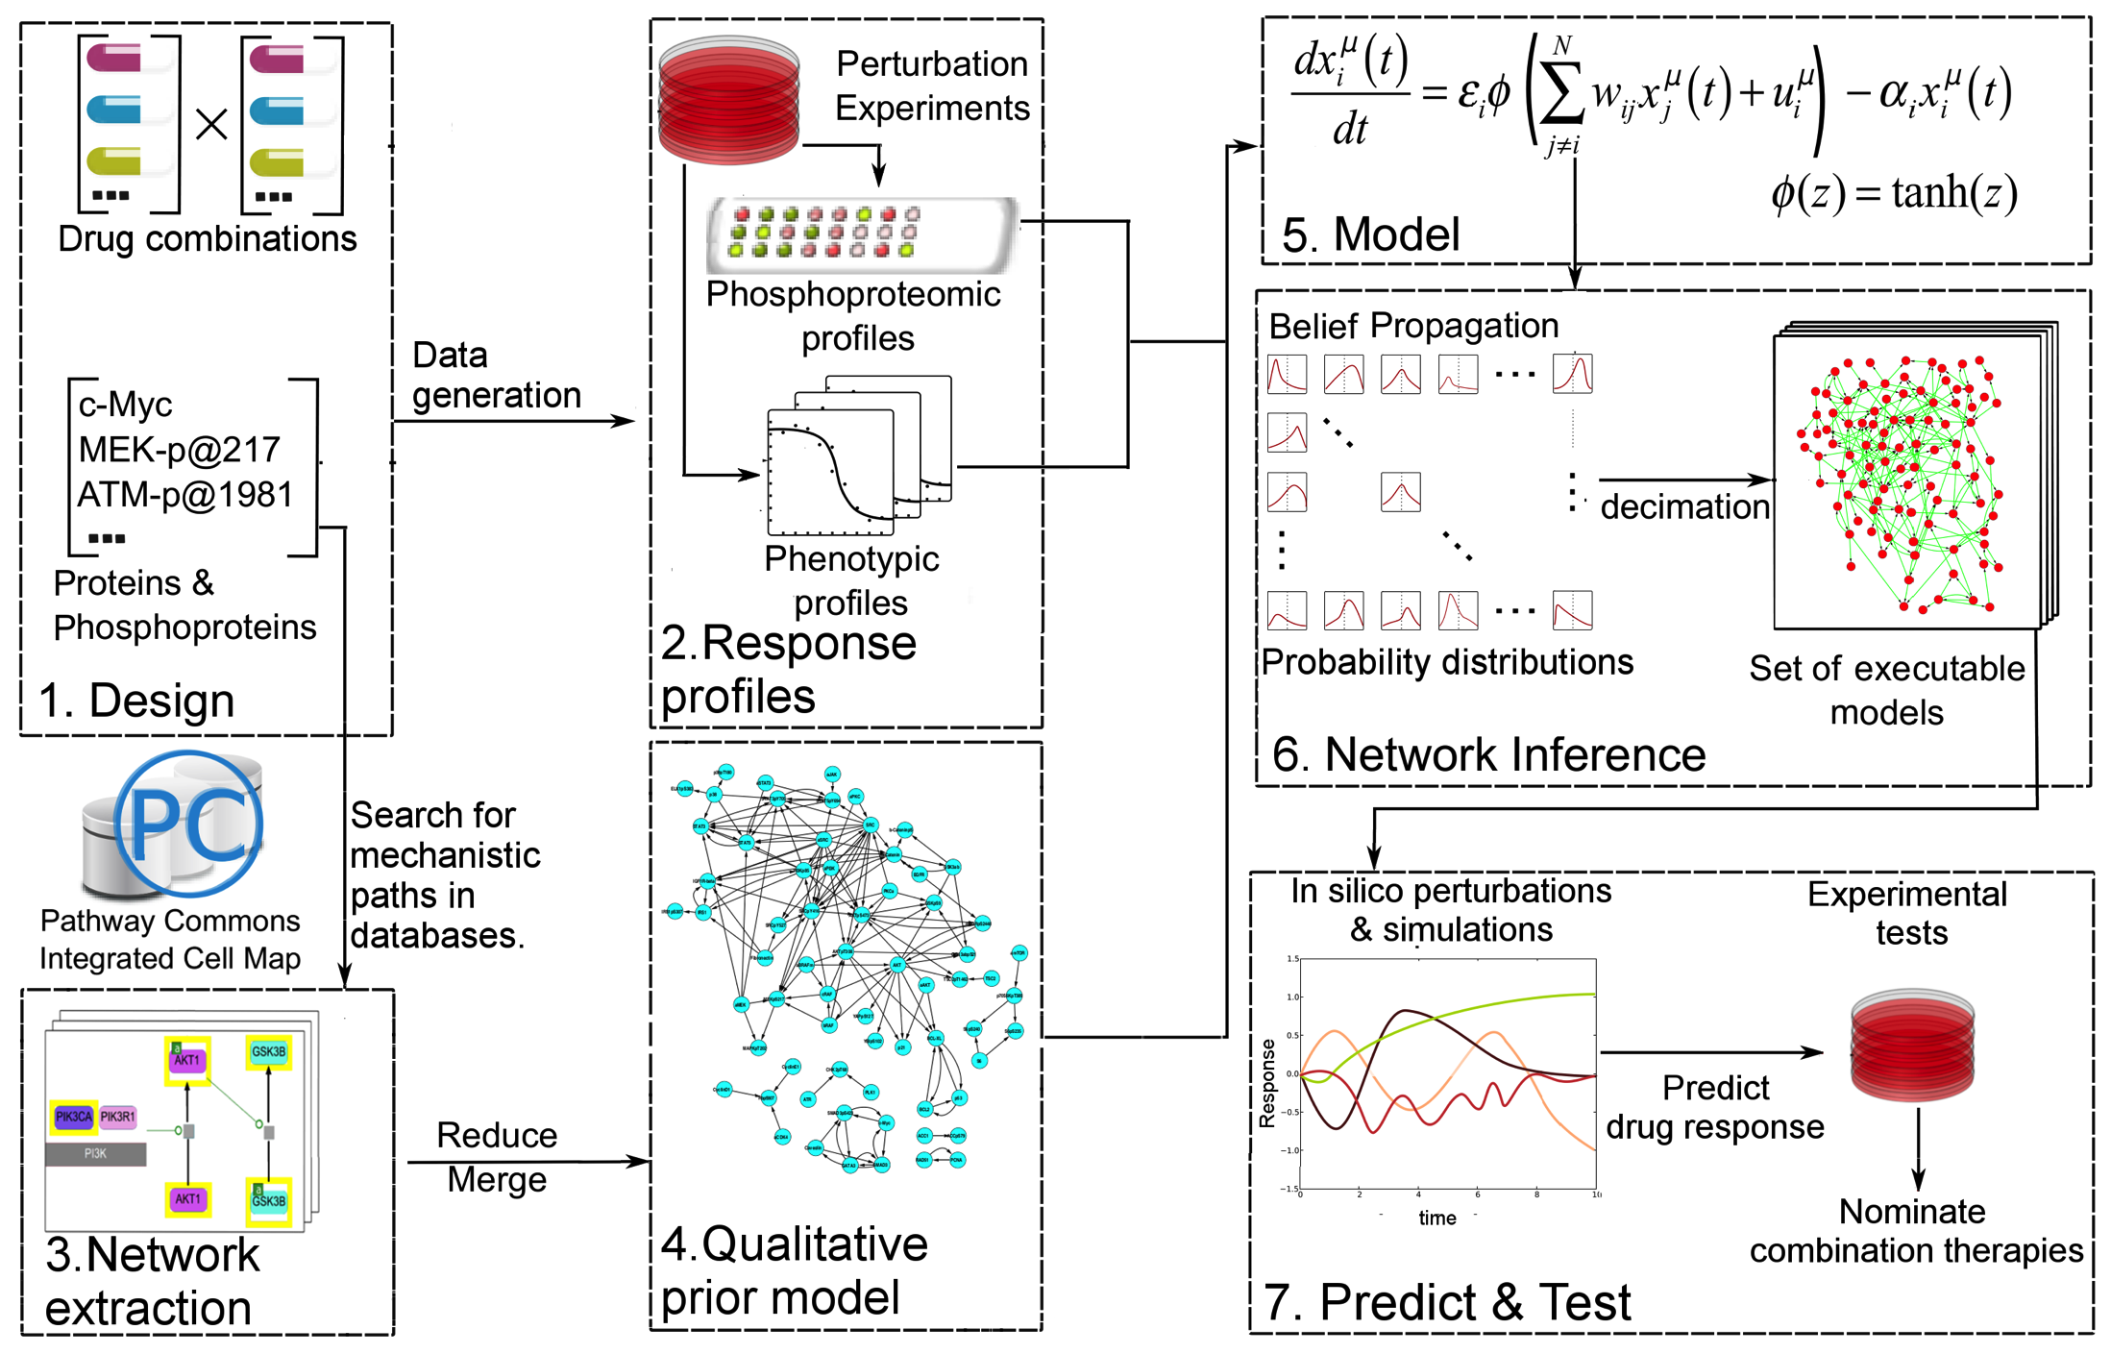
Perturbation Biology: Analyzing Drug Response Using De Novo Network Re-constructions Augmented with Prior Knowledge
Molinelli, EJ, (2013), PLoS Comp Bio; Korkut A. (2015), eLife.
Notes:
JQ1 (BRD4, acetylated histones) and MEK (inhibitor)

Slide 15
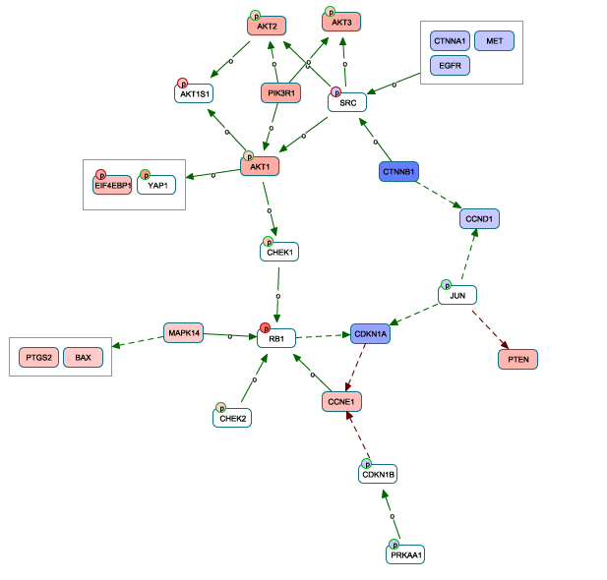
Identifying Interactions in Agreement with Experimental Data
Protein Abundance: Red: Increase, Blue: Decrease (either comparing 2 cell lines or doses)
Interactions (Solid): Phosphorylates; (Dashed): Red: Down-Regulates Expression, Green: Up-Regulates Expression
Babur, Ö, et al. in preparation

Slide 16
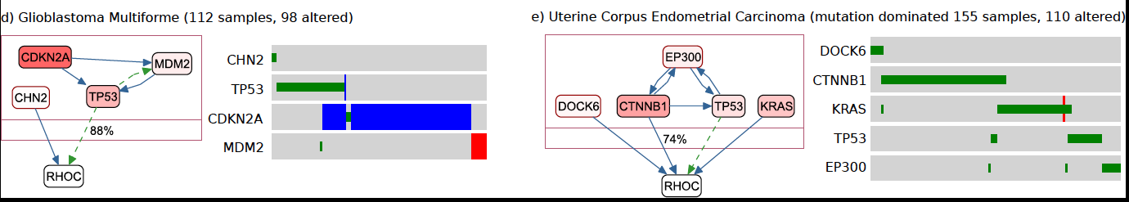
Mutually Exclusive Alterations in Pathways for Particular Cancers
Babur, Ö, et al. (2015), Genome Biology.

Slide 17
Acknowledgements
MSKCC
Arman Aksoy
Ozgun Babur
Emek Demir
Onur Sumer
Eric Minwei
Jianjiong Gao
Nikolaus Schultz
Chris Sander
Bilkent University
Ugur Dogrusoz
University of Toronto
Gary Bader
Igor Rodchenkov
Max Franz
Uniprot/Enzyme Portal
Maria Martin
Xavier Watkins
Bioconductor
Paul Shannon
Marc Carlson
Notes:
Add Ed and Rileen

